Slide 1

Deploy eox microservices using cloud platform service and improve scalability.
UE20CS390B – Capstone Project Phase – 2
Project Progress Review #3
Project Title : Deploy EOX microservices using cloud platform service and improve scalability.
Project ID : PW_23_VP_01
Project Guide : Prof Venkatesh Prasad, Mr.Vijay R(EOX Vantage)
Project Team : Veena Garag PES1UG20CS492
Adarsh Kumar PES2UG20CS016
Suchit S Kallapur PES1UG20CS438
Yuvaraj D C PES1UG20CS521

Slide 2
Deploy eox microservices using cloud platform service and improve scalability.
Abstract and Scope
Project deals with deploying microservices on cloud and reduce the resource consumption such as CPU and bring down the cost of creation of pods.
The project is aimed to improve and optimise resource utilization, improve security feature and be able to monitor the performance and visualize the metrics in order to study the behaviour of the microservices to increased load.

Slide 3
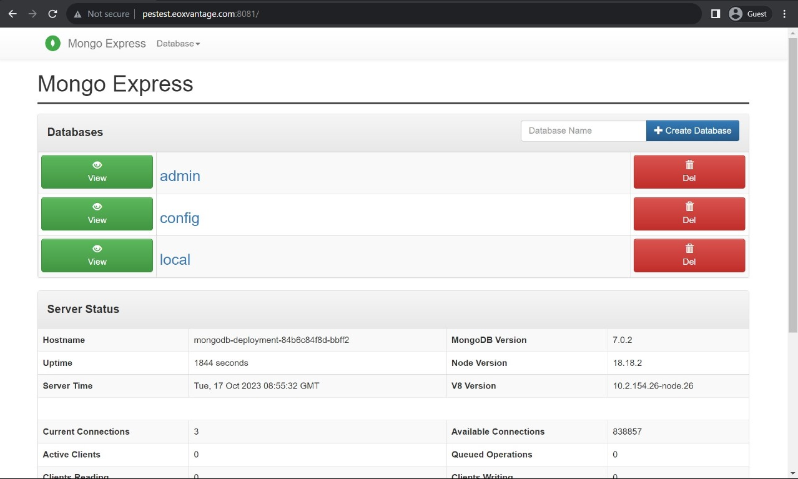
Deploy eox microservices using cloud platform service and improve scalability.
Exposed
Recap
Successfully deployed the Application on the live server and the services were able to accept and serve the external requests.

Slide 4
Deploy eox microservices using cloud platform service and improve scalability.
Suggestions from Review - 2
Implementation of the custom scheduler in a demo Application on the live server.

Slide 5
Deploy eox microservices using cloud platform service and improve scalability.
Implementation Details
Load Generator:
Here we are using Locust to generate load as per our needs to test the custom scheduler.
We can set the Spawn Rate(Number of requests by user/sec) to do a certain task as well as total number of users such that load being generated will give chart values as well as statistical values that will be useful for testing purposes.
Metrics Server:
We are using the Metrics Server tool to get live metrics such as CPU and memory usage which is then used directly in the custom scheduler as well as for testing purposes.
Custom Scheduler:
The custom scheduler is a deployment service that scales the application’s pods based on the varying traffic load.

Slide 6
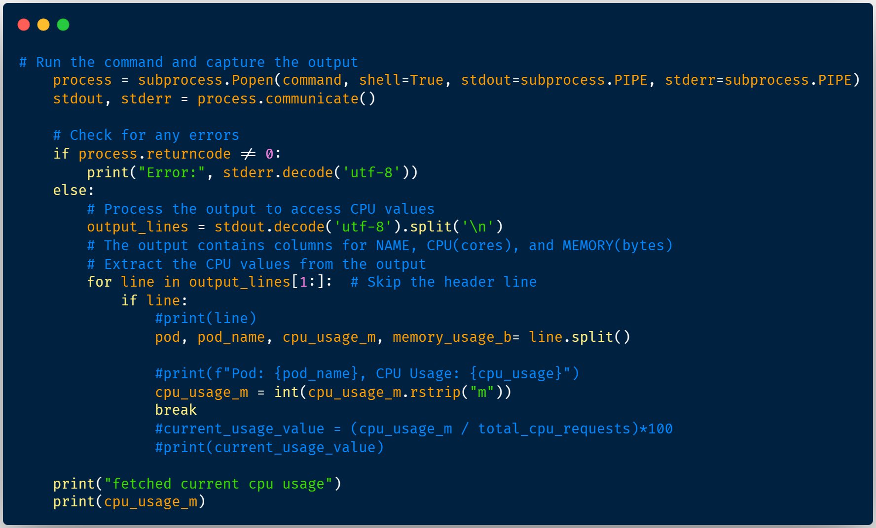
Deploy eox microservices using cloud platform service and improve scalability.
Implementation Details
Code Snippet to fetch the pod metrics using Kubernetes Metrics Server

Slide 7
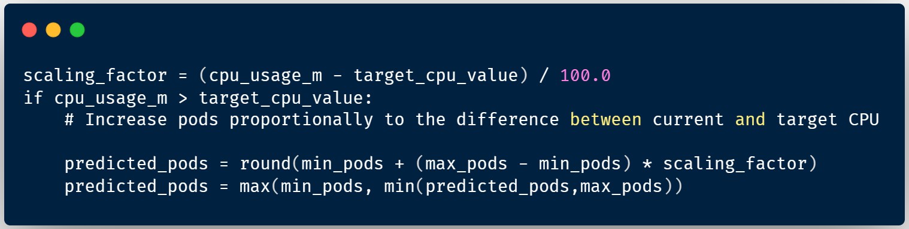
Deploy eox microservices using cloud platform service and improve scalability.
Implementation Details
Code Snippet that consists of the logic that calculates the number of pods required to create and delete pods.

Slide 8
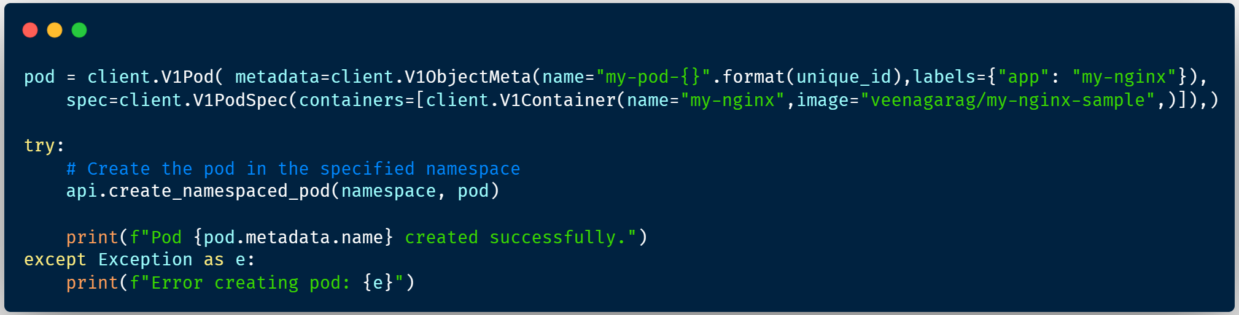
Deploy eox microservices using cloud platform service and improve scalability.
Implementation Details
Code Snippet that is used to create pods during scaling up.

Slide 9
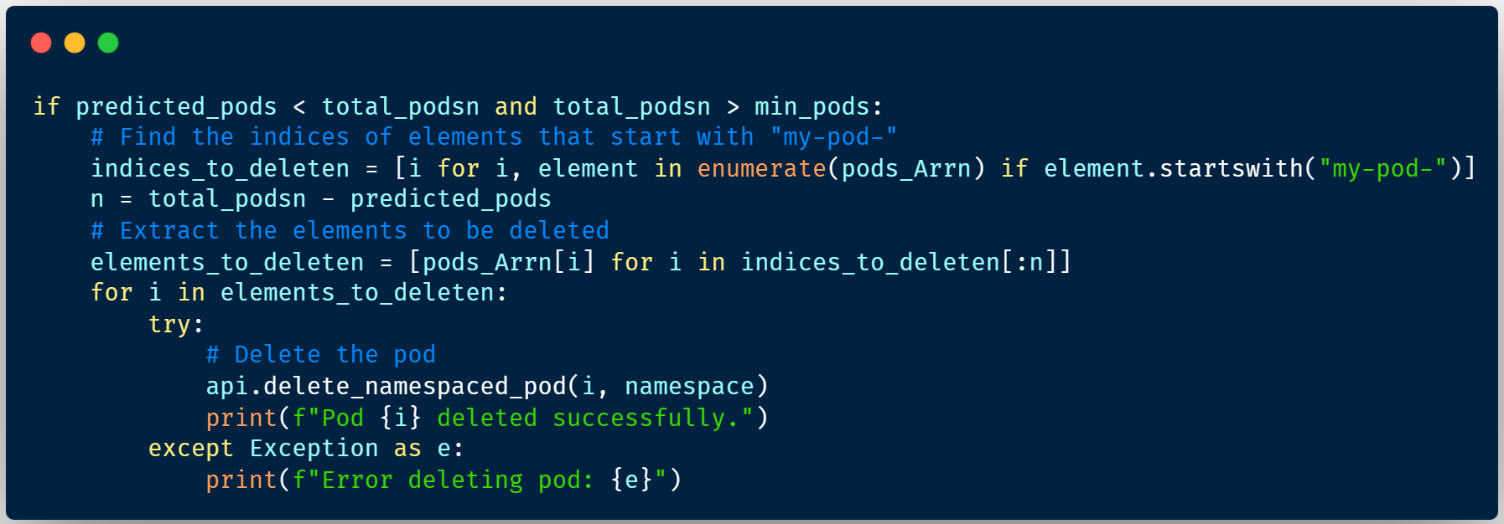
Deploy eox microservices using cloud platform service and improve scalability.
Implementation Details
Code Snippet that is used for deletion of pods to scale down.

Slide 10
Deploy eox microservices using cloud platform service and improve scalability.
Project Demonstration
Project Demonstration and the working of the Custom Scheduler will be done during the presentation.

Slide 11
Deploy eox microservices using cloud platform service and improve scalability.
Test Plan and Strategy
Functional Testing:
Curl – It is a command-line tool that can be used to make HTTP requests to Kubernetes resources on the live server like pods, services, and deployments. It is used to test connectivity and troubleshoot issues with Kubernetes resources.
Non Functional Testing:
Locust – It is an open source performance testing tool to test the scalability of the application on high load being generated by the tool.
The default provided Kubernetes Metrics Server as well as the Kubernetes Dashboard is used to check on the behavior of the application.

Slide 12
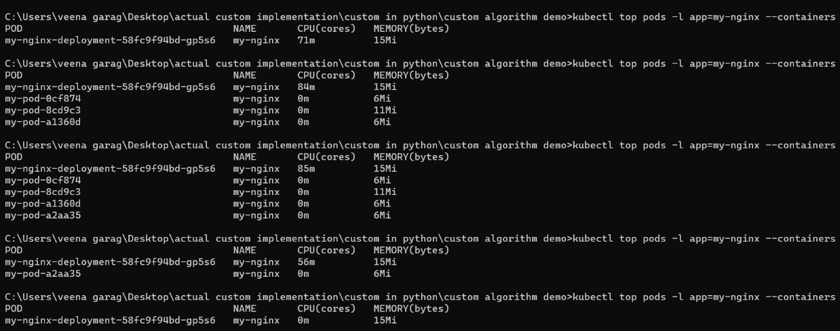
Deploy eox microservices using cloud platform service and improve scalability.
Results and Discussion
Results and discussions on the experimentation conducted after testing.
Are the results are same as expected? Is it as per initial estimates planned? If there is a deviation, give the reasons for the change.
Results obtained in comparison other with other technology/methodology including graphs/charts (if applicable).
Custom Scheduler working while scaling up and scaling down the application pods as Load varies on the application.

Slide 13
Deploy eox microservices using cloud platform service and improve scalability.
Timeline – Update on Tasks
Project Report is in the works.

Slide 14
Deploy eox microservices using cloud platform service and improve scalability.
Conclusion and Future work
Successfully able to scale up and down the Nginx application pods by using Custom Scheduler Algorithm.
Looking into the memory utilization of the pods.

Slide 15
Deploy eox microservices using cloud platform service and improve scalability.
References
Deshpande, Neha (2021) Autoscaling Cloud-Native Applications using Custom Controller of Kubernetes.
https://norma.ncirl.ie/5089/
Masters thesis, Dublin, National College of Ireland.
Shitole, Abhishek Sanjay (2022) Dynamic Load Balancing of Microservices in Kubernetes Clusters using Service Mesh.
https://norma.ncirl.ie/5943/
Masters thesis, Dublin, National College of Ireland.
An Efficient and Scalable Traffic Load Balancing Based on Web Server Container Resource Utilization using Kubernetes Cluster.(May – 2022) Ashok L Pomnar,
AVCOE Sangamner 422 605,Maharashtra, India.
https://ijisrt.com/assets/upload/files/IJISRT22MAY1644_(1)_(1).pdf
V. Sharma, "Managing Multi-Cloud Deployments on Kubernetes with Istio, Prometheus and Grafana," 2022 8th International Conference on Advanced Computing and Communication Systems (ICACCS), Coimbatore, India,
https://doi.org/10.1109/ICACCS54159.2022.9785124

Slide 16
Deploy eox microservices using cloud platform service and improve scalability.
IEEE Draft
The Project Draft Report is in the works.

Slide 17
Thank You

